Slide 1
Mediated Public Speaking

Slide 2
Mediated Public Speaking: Introduction
Mediated communication are messages transmitted through a mechanical or electronic medium.
Preparation and delivery for both speeches involving mediated communication and traditional face-to-face speeches are similar.

Slide 3
The Rise of Mediated Communication
Technological changes have created increasing options for public speakers to reach an audience.
Face-to-face presentations remain the gold standard of public speaking formats.
Mediated communication opens up new channels for distributing and viewing presentations.

Slide 4
The Rise of Mediated Communication (cont.)
The expansion of mediated public speaking
Mediated presentations include
Recording a presentation for class.
Participating in a job or scholarship interview on Skype.
Creating a YouTube video for a nonprofit organization.
Podcasting a program you produced.
Delivering a sales presentation by videoconference.

Slide 5
The Rise of Mediated Communication (cont.)
Use of mediated presentations is expanding.
Over 3/4 of colleges in a recent survey teach online classes.
Videoconferencing technology exceeds $7 billion worldwide and is expected to grow by almost 10% a year through 2019.
Many governmental organizations allow people to use technology such as Skype to make comments during public meetings.
This increases civic engagement for those who cannot attend public meetings in person.

Slide 6
The Rise of Mediated Communication (cont.)
Prerecorded and real-time presentations
A prerecorded or asynchronous presentation is recorded by the speaker for later viewing by one or more audiences.
A real-time or synchronous presentation
Is delivered directly to the audience as the speaker presents the message from a remote location.
Is similar to a face-to-face presentation, except that the audience and speaker are not together.

Slide 7
Advantages of Mediated Presentations
General advantages
Flexibility
Audience members can be at multiple and more convenient locations.
Prerecorded speeches can be viewed at different locations and at different times.
Savings
Travel time and money are saved.
Audience size
There are no limits on audience size.

Slide 8
Advantages of Mediated Presentations (cont.)
Advantages of prerecorded speeches
Do-overs
If you make a mistake, you can start over.
Editing may or may not be allowed in your class.
Pause and rewind buttons
Listeners have additional opportunities to process and reflect on your message.
Option to save
Recording makes a permanent record of your speech for future use.

Slide 9
Advantages of Mediated Presentations (cont.)
Advantages of real-time technologies
Audience feedback
Certain technologies allow audience feedback, letting you adapt your speech in the moment.
Audience interaction
Real-time technology allows audience members to interact with the speaker during or immediately after the speech.
Option to save
The audience may have the ability to go back to any point in your speech for clarification or reinforcement.
If you are able to record your real-time speech, you have the opportunity to share it with an even wider audience later.

Slide 10
Challenges of Mediated Presentations
Loss of naturalness
Naturalness is determined by the extent to which it matches the features of face-to-face interaction.
Key factors that contribute to naturalness include
Sharing the same space.
Sending and receiving messages quickly.
Being able to send and receive both verbal and nonverbal expressions.

Slide 11
Challenges of Mediated Presentations (cont.)
Loss of immediacy
A sense of connection is reduced when the speaker and audience do not share the same space.
Speakers face greater challenges establishing credibility and building common ground.
You may feel less of a bond with the audience when presenting to a camera.

Slide 12
Challenges of Mediated Presentations (cont.)
Decreased nonverbal communication
Mediated presentations limit and alter how listeners see and interpret the speaker’s nonverbal messages.
Diminished feedback
The speaker cannot gauge audience interest, comprehension, or positive reactions.

Slide 13
Challenges of Mediated Presentations (cont.)
Difficulty managing distractions
Multitasking is juggling multiple tasks with and without technological devices.
Listeners are more likely to multitask when the speaker is in a different location.
Speakers lose opportunities to use nonverbal strategies to regain audience attention.
They have few or no opportunities to notice things that are distracting listeners.

Slide 14
Challenges of Mediated Presentations (cont.)
Technological difficulties
Prevent technological issues by
Download and install everything you need beforehand
Practicing with the technology beforehand.
Making sure a backup device is available.
Opening a Web site in a different browser or disconnecting and reconnecting to the Internet.

Slide 15
Optimizing Delivery and Messages in Mediated Presentations
Delivery considerations
Voice
Speak at the same volume you would use when addressing people seated in a conference room.
If you are prerecording, do a quick “voice check” by recording yourself saying the beginning of your introduction and playing it back to ensure appropriate volume.
Maintain an effective rate of speaking, and pause at natural stopping points in your speech.
Imagine you are speaking to a live audience, and try to maintain an energetic delivery.
Consider asking the audience to use high-quality ear buds when listening to you.

Slide 16
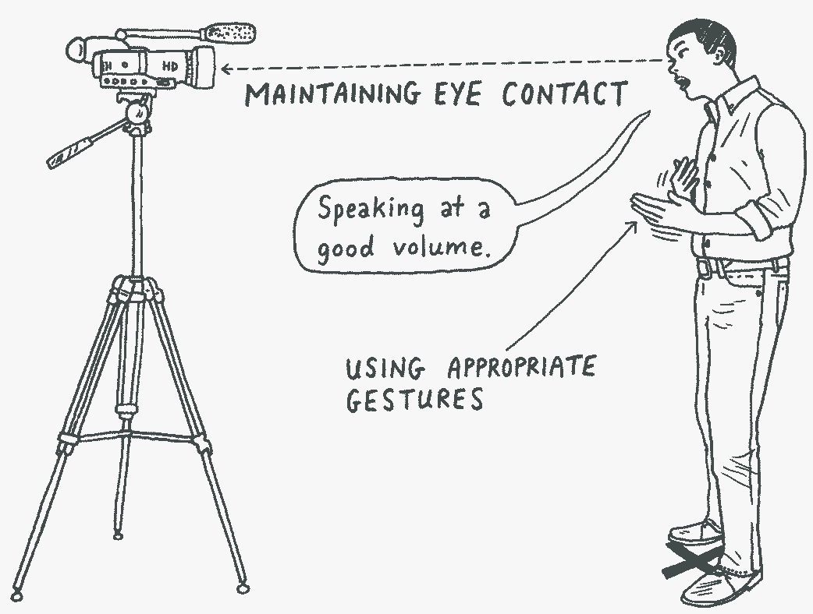
Optimizing Delivery and Messages in Mediated Presentations (cont.)
Eye contact
Look toward the camera while presenting.
Make extended eye contact in several directions, just as you would with a live audience.
Movement and gestures
Don’t gesture too expansively.
Ensure that all movement remains within the range of your camera so that you do not move in and out of the screen.

Slide 17
Optimizing Delivery and Messages in Mediated Presentations (cont.)
Practicing delivery and recording
Practice as you would for face-to-face.
Review your practice recordings.
Are your rate and volume appropriate?
Do you appear to be looking at the audience?
Can all of your movements and gestures be seen?
Are your presentation aids both visible and on screen long enough for viewers to process?
Does the setting of your speech look professional?
Do the lighting and background make a clear picture of you?

Slide 18
Optimizing Delivery and Messages in Mediated Presentations (cont.)
Have the camera operator record your practice to become familiar with the equipment and your speech.
During your “final take,” allow sufficient time for a do-over, and watch it to make sure it is a quality recording.
Save the recording to more than one place.

Slide 19
Recording Your Classroom Speech
Camera
You can use an iPad, smartphone camera, or other camera.
If you use a smartphone to shoot video,
Use a tripod, where possible.
Shoot your video horizontally instead of vertically.
Shoot a sample, and replay it to check lighting and sound quality.
Edit on a computer where you have a large screen and can see everything in more detail.

Slide 20
Recording Your Classroom Speech (cont.)
Setting and background
Be sure the background looks professional.
Avoid background noises.
Place the primary source of light behind the camera operator and directed toward the speaker.
It is generally better to have more light than less.

Slide 21
Recording Your Classroom Speech (cont.)
Attire
Select clothing that is appropriate for public speaking and will make a good impression on camera.
Single, neutral colors are recommended.
Jewelry should not make noise.
Record and view a practice speech to see how you and your speech setting will appear to the audience.

Slide 22
Recording Your Classroom Speech (cont.)
Camera positioning
Be sure the view is wide enough to capture your movement and gestures.
Avoid using a “talking head” shot.
If a cell phone camera is used, place it on a flat surface to avoid camera shakiness.
Position the camera to the level of your eyes.
Consider changing the camera shot, which is challenging but can enliven your speech.

Slide 23
Special Considerations for Real-Time Presentations
Practice with your equipment to make sure your technology works.
It is vital to practice real-time mediated speeches with the technology you plan to use.
Select a robust Internet connection.
An Ethernet connection is preferred over wifi.

Slide 24
Video Conferencing Guidelines
Watch the videos in Module 1 for more guidelines for video conferencing!

